Slide 1
Taiwan High Speed Rail Corporation 1~3Q, 2025 Operation Report
Ticker Symbol: 2633
2025.12.05

Slide 2
Safe Harbor Notice
The information contained in this presentation and its accompanying announcements, including content relating to business outlooks, financial operations, and business forecasts, is based on information derived from internal corporate data and external economic developments as a whole.
The Company's actual operations, financial conditions, and operational performance may differ from forecasted information; this may be due to various factors including but not limited to market demand, changes in policies and regulations and overall economic conditions, and other factors or risks beyond the Company’s control.
The information provided in this presentation reflects the Company's current views about the future; correctness, completeness, or reliability of said views are not explicitly or implicitly expressed or warranted. The Company is not responsible for updating or amending changes or adjustments made to the contents of this presentation, if such changes or adjustments should occur in the future.
For the convenience of readers, this presentation has been translated into English from an original Chinese version. If there is any conflict between the English version and the original Chinese version or any difference in the interpretation of the two versions, information in the Chinese-language presentation shall prevail.
Notes:
Taiwan High Speed Rail – Alignment
Here we can see the HSR alignment and the location of each station and maintenance base.
From north to south, we have 12 planned stations, namely,
Taipei Nangang
Taipei Main Station
Taipei Banciao
Taoyuan
Hsinchu
Miaoli
Taichung
Changhua
Yunlin
Chiayi
Tainan
Kaohsiung Zuoying
Besides Taipei Nangang station, Miaoli station, Changhua station and Yunlin station, the other eight stations are already in service.
Also, there are five maintenance bases. From north to south, they are
Hsinchu Lioujia Depot,
Taichung Wurih Depot
Chiayi Taibao Depot,
Kaohsiung Yanchao Main Workshop, and
Zuoying Depot

Slide 3
AGENDA
I. OPERATIONAL OVERVIEW
II. FINANCIAL RESULTS
III. OPERATIONAL OUTLOOK

Slide 4
I. OPERATIONAL OVERVIEW

Slide 5
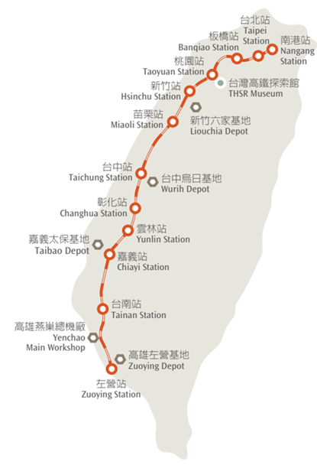


Company Profile
Operation Length
Operation Area
Train Set
Stations
Maintenance Depots
Max Operating Speed
350
11
34
12
5
300
km
cities
sets
sets
sets
Km/hr
Weekly Schedule | Daily Two-way Service (WEEKEND) | Daily Two-way Service (WEEKDAY)
1,128 | 182 | 148
Passenger Transportation Services
Offers direct train, semi- direct train, and stopping train transport.
Operation of Affiliated Business
Space Leasing:(Convenience store, dining, service counter, etc.) Advertising Sales:(Lightboxes, wall space, column space, product displays, train decorations, etc.) Retail Business Trolley Sales Parking Lots at Stations

Slide 6
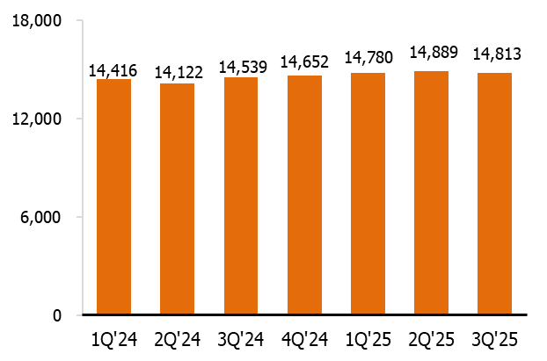
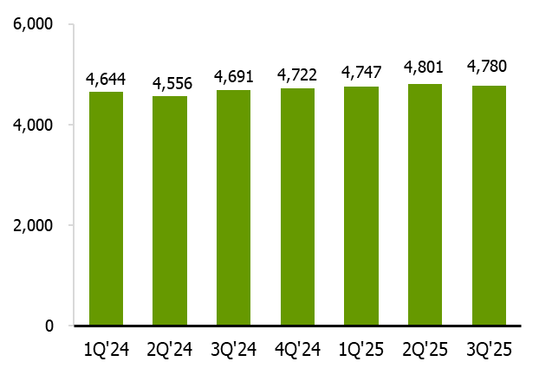
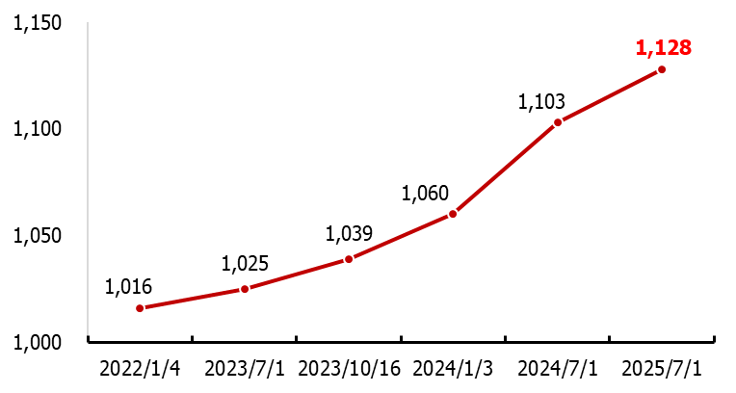
Transportation Capacity
Train Services
(mn-km))
Seat-Km
(frequency)
(frequency)
Trend of Train Services Status

Slide 7
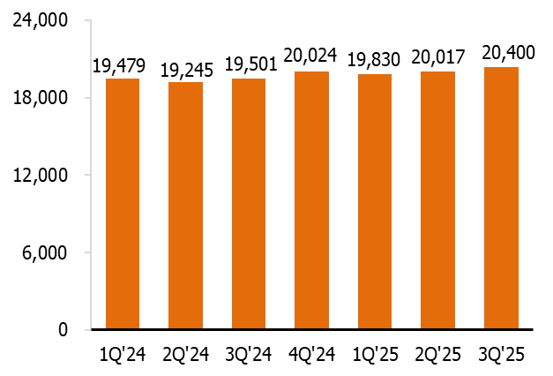
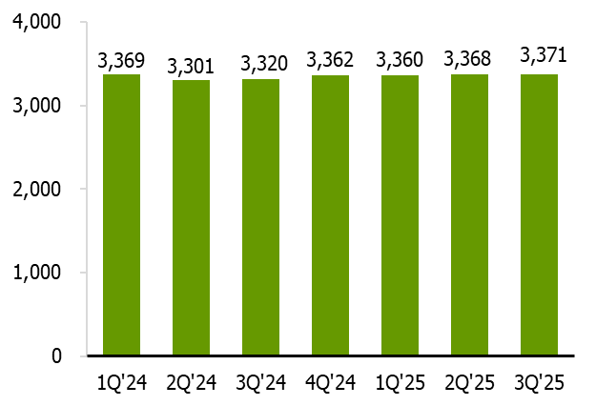
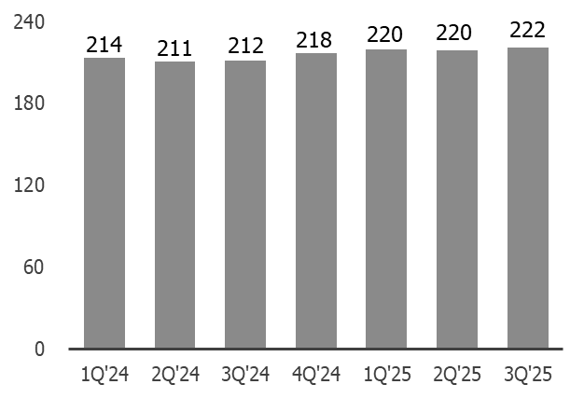
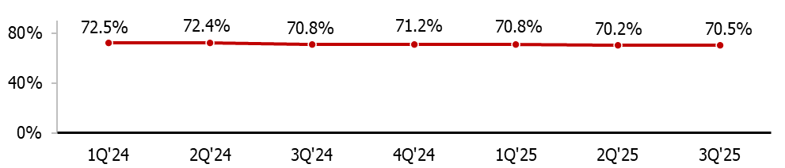
Transportation Volume
(thousand persons)
Passenger
Passenger-Km
(thousand persons/day)
Daily Avg. Ridership
(mn-km)
 | 3Q'25 | 2Q'25 | QoQ | 1~3Q'25 | 1~3Q'24 | YoY
Passenger (thousand persons) | 20,400 | 20,017 | + 1.9% | 60,247 | 58,226 | + 3.5%
Passenger-Km (mn-km) | 3,371 | 3,368 | + 0.1% | 10,099 | 9,989 | + 1.1%
Daily Avg. Ridership (thousand persons/day) | 222 | 220 | + 0.8% | 221 | 213 | + 3.9%
Load Factor

Slide 8
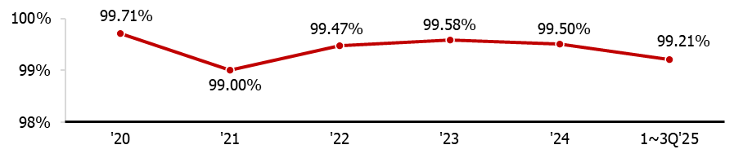
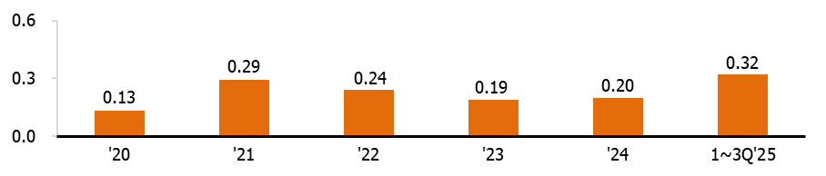
5-Year Operation Performance
Punctuality
(Delay<5min)
(min)
Avg. Delay Time
'20 | '21 | '22 | '23 | '24 | 1~3Q'25
0 | 0 | 0 | 0 | 0 | 0
Accidents resulting in Liabilities

Slide 9
II. Financial Results
Notes:
9

Slide 10
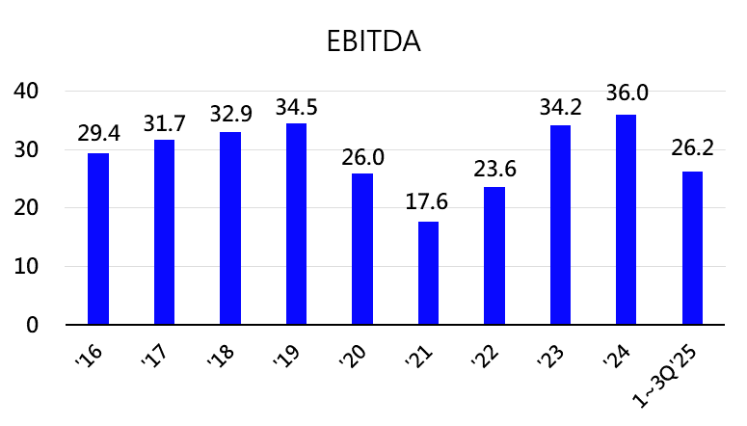
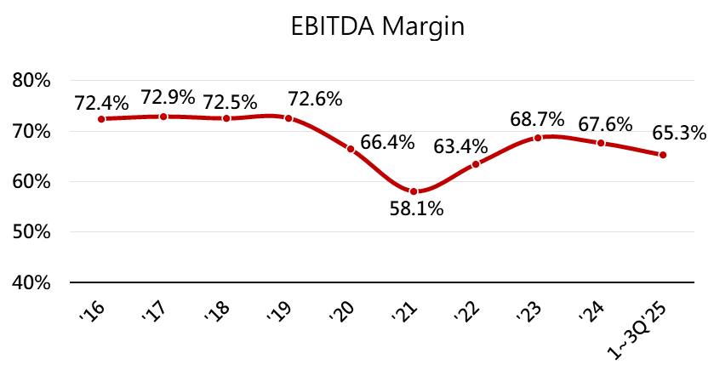
Profit & Loss and Financial Results
(NT$bn)

Slide 11
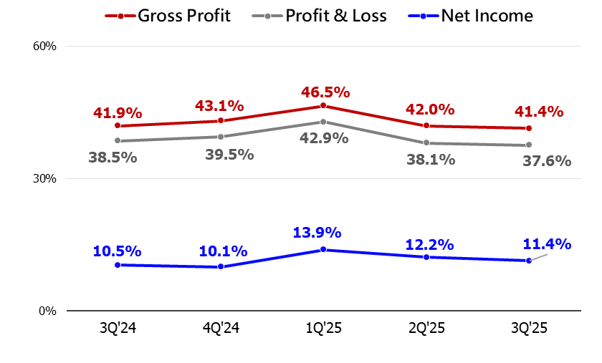
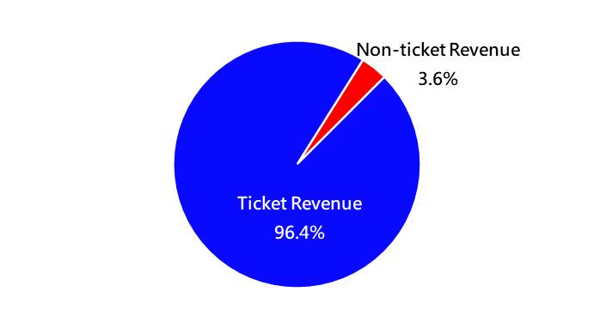
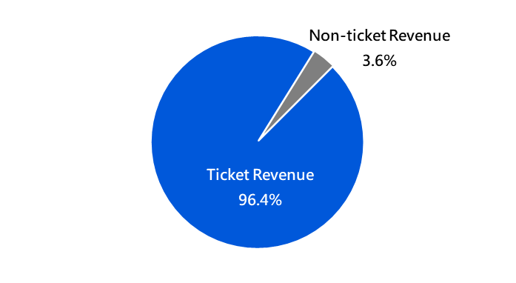
Revenue Structure and Profit & Loss
1~3Q’25 Revenue Mix
1~3Q’24 Revenue Mix
Note: Non-ticket revenues mainly include: rental income, advertising sales, and trolley sales.

Slide 12
Cash Flows
[註1]
[註2]
[註3]
Note 1: Stabilization reserve account withdrew $7.16 bn in 3Q, 2025.
Note 2: The total net cash outflow of money market funds (MMF) and >3-mth fixed deposits/RP decreasing $6.90 bn, capital expenditure totaling $6.86 bn in 1- 3Q, 2025.
Note 3：In 1-3Q, 2025, the issuance quota of non-guaranteed commercial paper reduced NT$ 1.575 bn,
issued $1 bn in ordinary corporate bonds, repaid $4 bn in corporate bonds, and distributed $5.9 bn in
cash dividends.

Slide 13
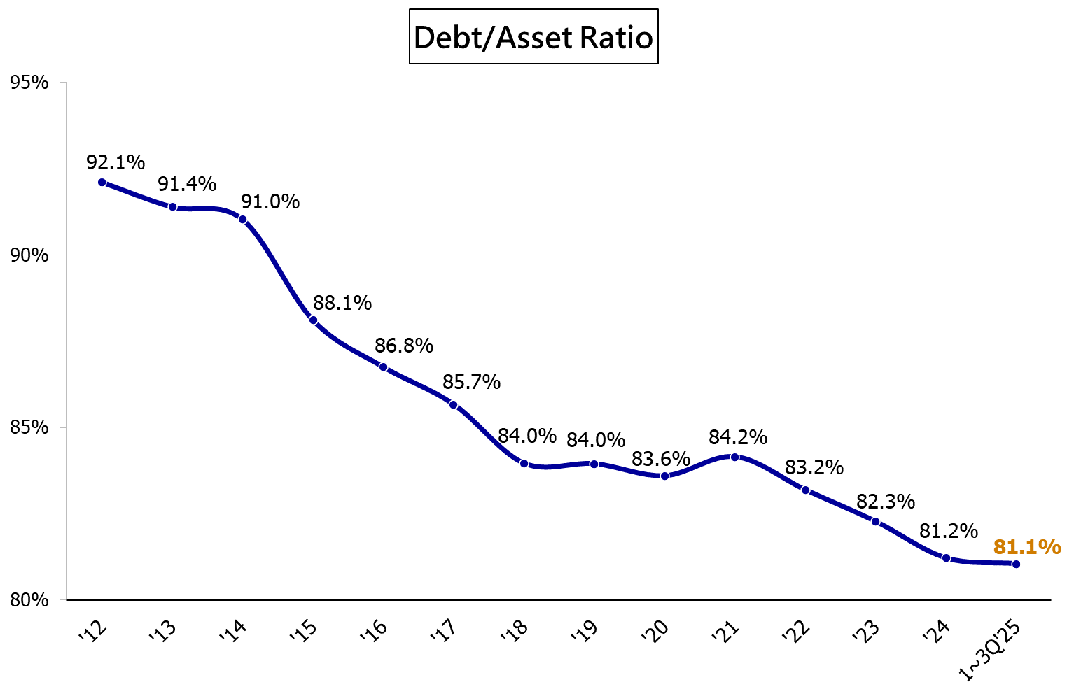
Financial Risk Management
Total early payment of syndicated loan, from 2016 to 2025.
(NT$billion) | Amount
’16 | 21.0
’17 | 41.2
’18 | 10.0
’20 | 18.5
’21 | 15.0
’22 | 25.0
’23 | 10.0
Total | 140.7
Note：Ratio of liabilities to assets = total liabilities/total assets

Slide 14

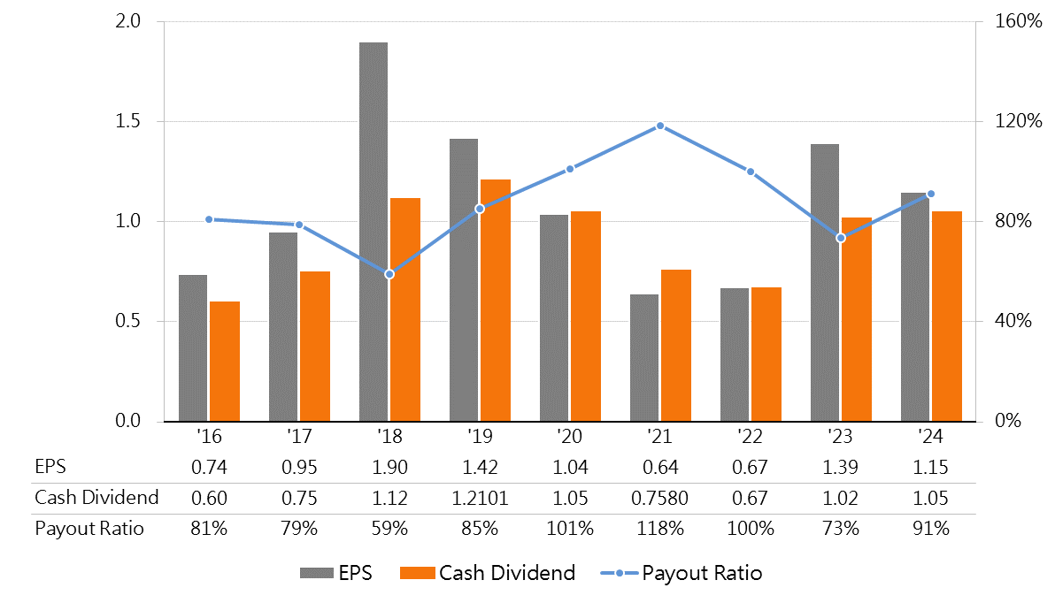
EPS & Cash Dividend
Unit：NT$
Note : The calculation of earnings per share is based on the weighted average number of ordinary shares of 5.628 billion shares.

Slide 15
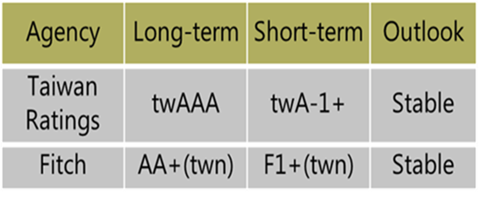
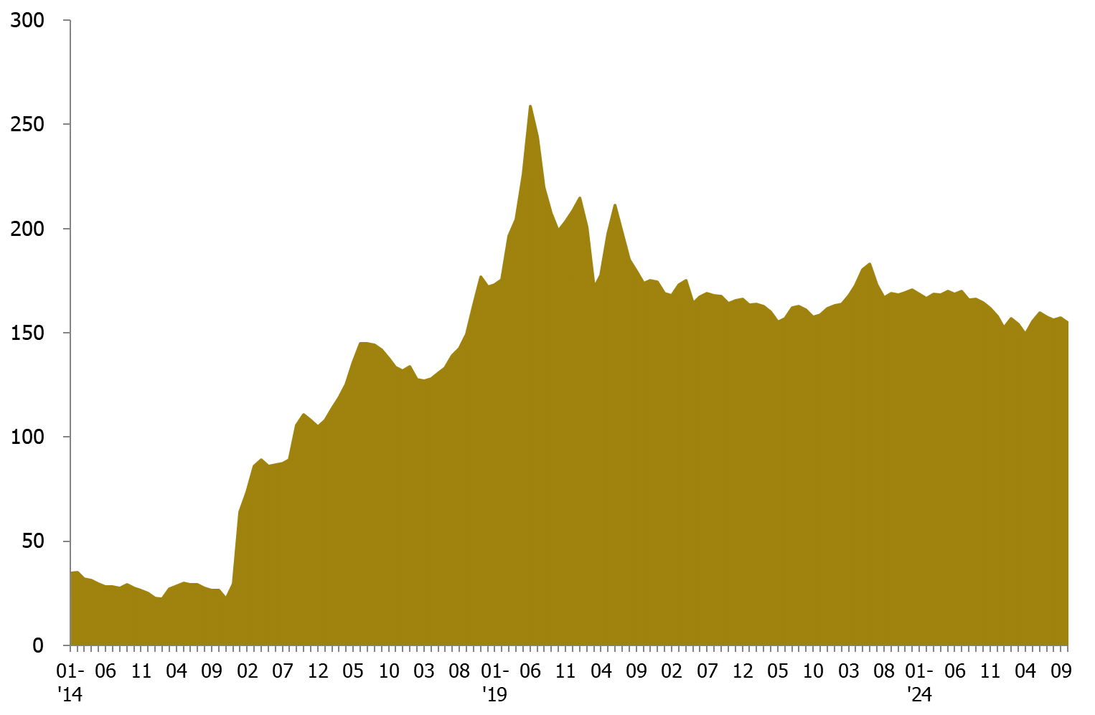
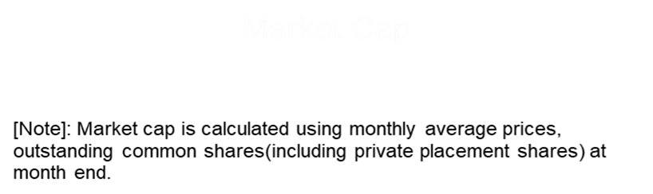
Corporate Credit Ratings & Market Cap
NT$ billion
Oct. 2025
Market Cap
NT$154.7bn
Copyright © Taiwan High Speed Rail Corporation. All Contents Confidential.
Notes:
15

Slide 16
III、 OPERATIONAL OUTLOOK
Notes:
16

Slide 17




Revenue Growth Momentum
2025 Operational Growth Strategy
Transport capacity improvement：Increase the regular and short-term train schedule, and temporarily adjust cabin type for the non-reserved seats.
Transport volume growth：Enhance the cross-industry cooperation to expand passenger sources and add promotions during off-peak hours.
Tourism Products：Launch diversified products for the international travel market, aiming at T-holidays/hotel and overseas coupons.
Membership Economy：Improve the economic effect of the points of more than 3.0 million TGo members of the high-speed rail and increase the stability of members.
Non-ticket Revenue：Promote products on the shopping platform "T-Shopping High-Speed ​​Rail Online Shopping" and increase non-ticket revenue through co-branded products.
Passenger Services：Update passenger information displays and blackout curtains in carriages, modify train toilet equipment, issue new QR Code paper tickets and other passenger service facilities to enhance passenger travel experience.

Slide 18

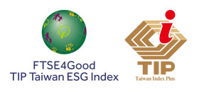

ESG Promote and Awards
To be the platform for advancement and enjoyment.
THSRC not only provides passengers with safe, fast, and punctual transportation services, but also cooperates and builds alliances with external industries to enhance our railway capabilities. THSRC also strives to provide passengers with comprehensive, high-quality life experiences through integration of advanced technology, local culture, and environmental protection.
Received the Taiwan Corporate Sustainability Awards for 8 consecutive years.
Won the “Gold Award” for Corporate Sustainability Report
2017-2024
Selected as a constituent of the FTSE4Good TIP Taiwan ESG Index for 7 consecutive years.
2019-2025
Selected for the TWSE RA Taiwan Employment Creation 99 Index for 6 consecutive years.
2020-2025
Received top 5% ranking in the Corporate Governance Evaluation for 8 consecutive years.
2018-2025
Selected as one of the Top 100 Global Sustainable Companies by Corporate Knights for 3 consecutive years. 2022-2024
THS​​RC 2025 "Enterprise Value Enhancement Plan" was announced on the "Enterprise Value Enhancement Plan Zone" of the Market Observation Post System, demonstrating its commitment to sustainable governance.

Slide 19
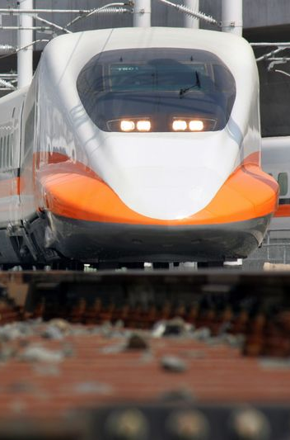
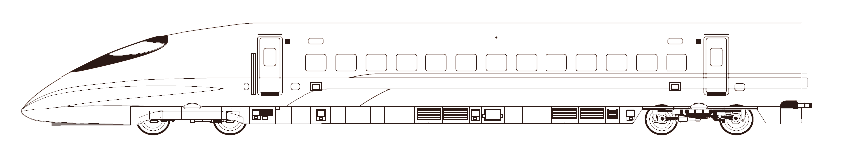
To learn more about THSRC,
please visit
http://www.thsrc.com.tw
Notes:
19

